Slide 1

Pact property checking system

Slide 2
Pact: introduction
Intentionally simple language
No loops; non-Turing complete
Data stored in tables owned by the contract (think: SQL)
Simple, first-class authorization constructs (“keysets”)
Transactional semantics (and enforce)
Notes:
Keyset = set of public keys = set of users authorized for some action

Slide 3
Pact: tables
(defschema account
“A user account”
balance:integer
ks:keyset)
(deftable accounts:{account})
balance
ks
alice
10
[“d37126b”]
bob
5
[“5fca08d”]
Notes:
Schema = record

Slide 4
Pact: a function
(defun transfer (from to amount) "Transfer money between accounts" (let ((from-bal (at 'balance (read accounts from))) (to-bal (at 'balance (read accounts to)))) (update accounts from { "balance": (- from-bal amount) }) (update accounts to { "balance": (+ to-bal amount) })))

Slide 5
Pact: optional types
(defun transfer (from:string to:string amount:integer) "Transfer money between accounts" (let ((from-bal (at 'balance (read accounts from))) (to-bal (at 'balance (read accounts to)))) (update accounts from { "balance": (- from-bal amount) }) (update accounts to { "balance": (+ to-bal amount) })))

Slide 6
Pact: authorization
(defun transfer (from:string to:string amount:integer) "Transfer money between accounts" (let ((from-bal (at 'balance (read accounts from))) (to-bal (at 'balance (read accounts to)))) (update accounts from { "balance": (- from-bal amount) }) (update accounts to { "balance": (+ to-bal amount) })))

Slide 7
Pact: authorization
(defun transfer (from:string to:string amount:integer) "Transfer money between accounts" (let ((from-bal (at 'balance (read accounts from)))
(from-ks (at 'ks (read accounts from))) (to-bal (at 'balance (read accounts to))))
(enforce-keyset from-ks) (update accounts from { "balance": (- from-bal amount) }) (update accounts to { "balance": (+ to-bal amount) })))

Slide 8
Pact: enforcing an invariant
(defun transfer (from:string to:string amount:integer) "Transfer money between accounts" (let ((from-bal (at 'balance (read accounts from)))
(from-ks (at 'ks (read accounts from))) (to-bal (at 'balance (read accounts to))))
(enforce-keyset from-ks) (update accounts from { "balance": (- from-bal amount) }) (update accounts to { "balance": (+ to-bal amount) })))

Slide 9
Pact: enforcing an invariant
(defun transfer (from:string to:string amount:integer) "Transfer money between accounts" (let ((from-bal (at 'balance (read accounts from)))
(from-ks (at 'ks (read accounts from))) (to-bal (at 'balance (read accounts to))))
(enforce-keyset from-ks)
(enforce (>= from-bal amount) "Insufficient Funds") (update accounts from { "balance": (- from-bal amount) }) (update accounts to { "balance": (+ to-bal amount) })))
Notes:
This is enforced at run-time

Slide 10
Property checker motivation
Smart contracts have been repeatedly exploited
On Ethereum: DAO attack, Parity multisig wallet bug, batchOverflow, etc.
Security is holding us back from nontrivial distributed apps
Pact is safer than Solidity, but smart contract authors still make mistakes!
Unit tests are not sufficient vs adversaries
Notes:
Answers for how we’re addressing each of these kinds of attacks:
DAO: Reentrance is not possible in Pact
Parity wallet: Use a keyset auth property to declare that the keyset is always checked
batchOverflow: arbitrary precision integers

Slide 11
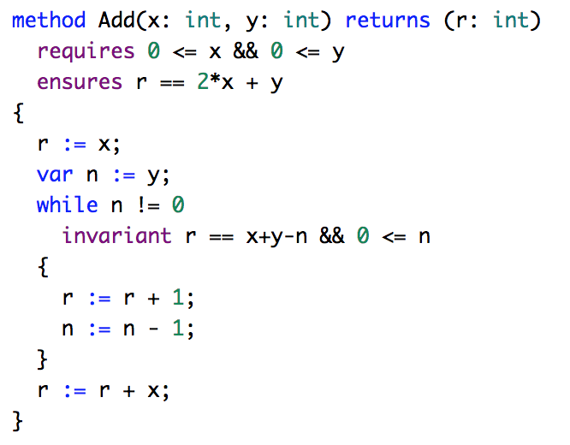
Dafny
Notes:
https://rise4fun.com/Dafny/Add

Slide 12
Liquid Haskell?

Slide 13
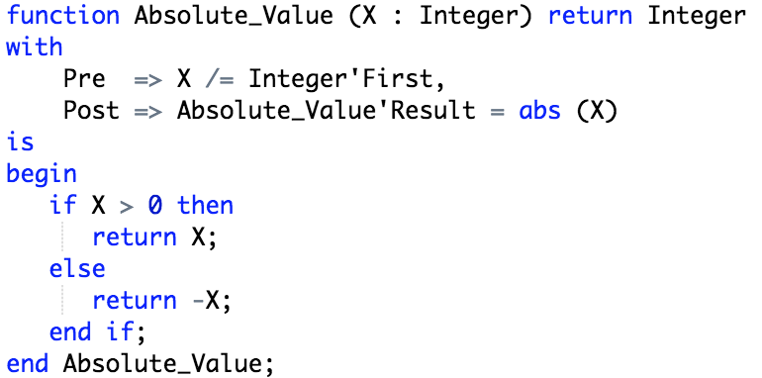
Ada / SPARK
Notes:
https://www.adacore.com/sparkpro
Used in:
avionics and air traffic control
commercial rockets such as the Ariane 4 and 5
satellites and other space systems
railway transport
Banking
fly-by-wire system software in the Boeing 777

Slide 14
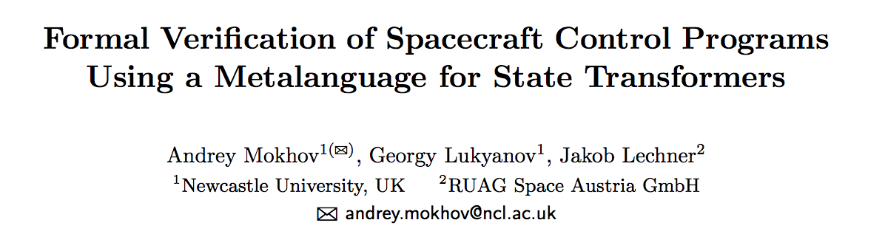
REDFIN

Slide 15
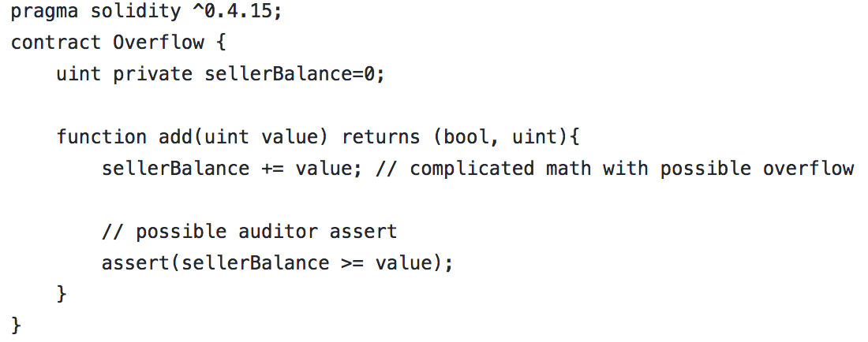
Manticore

Slide 16
The Pact property checker
A static analysis tool built into Pact
Uses Microsoft’s Z3 theorem prover
Enforce schema invariants & function properties for all possible inputs and program states
No background in formal verification required
Not an interactive theorem prover -- enforces contracts on functions
Notes:
Invariants = something like refinements

Slide 17
Schema invariants
Declared on the fields of a table’s schema
(defschema account
“A user account”
balance:integer
ks:keyset)

Slide 18
Schema invariants
Declared on the fields of a table’s schema
(defschema account
(“A user account”
(invariant (> balance 0)))
balance:integer
ks:keyset)
Notes:
(refinement)

Slide 19
Function properties
Checker verifies that the desired property on a function always holds
(defun abs:integer (x:integer)
“Returns the absolute value of an integer”
(if (< x 0)
(- x)
x))

Slide 20
Function properties
Checker verifies that the desired property on a function always holds
(defun abs:integer (x:integer)
(“Returns the absolute value of an integer”
(properties
[(>= result 0)]))
(if (< x 0)
(- x)
x))

Slide 21
Function properties
Checker verifies that the desired property on a function always holds
(defun abs:integer (x:integer)
(“Returns the absolute value of an integer”
(properties
[(>= result 0)
(not (table-read ‘accounts))
(not (table-write ‘accounts))]))
(if (< x 0)
(- x)
x))
Notes:
This is pure (mod failure)

Slide 22
The mass conservation property
For fungible assets
Applied to a particular column
Nothing “created or destroyed”
balance
ks
alice
10
[“d37126b”]
bob
5
[“5fca08d”]
carol
85
[“b900da0”]
TOTAL
100

Slide 23
The mass conservation property
For fungible assets
Applied to a particular column
Nothing “created or destroyed”
balance
ks
alice
10
[“d37126b”]
bob
5
[“5fca08d”]
carol
85
[“b900da0”]
TOTAL
100

Slide 24
The mass conservation property
For fungible assets
Applied to a particular column
Nothing “created or destroyed”
balance
ks
alice
0
[“d37126b”]
bob
15
[“5fca08d”]
carol
85
[“b900da0”]
TOTAL
100

Slide 25
Demo
Notes:
money supply
balance transfer
Note that the semantics are transactional, so most of the time we only care about transactions that succeed.

Slide 26
How does it work?
Translate Pact code to SMTLib
Translate desired property to SMTLib
Assume schema invariants hold on DB reads
Check invariants on DB writes
Ask Z3 to produce an input that violates an invariant or a property
Can’t generate an input? Invariants are maintained; Property is valid
Notes:
TODO: mention SBV

Slide 27
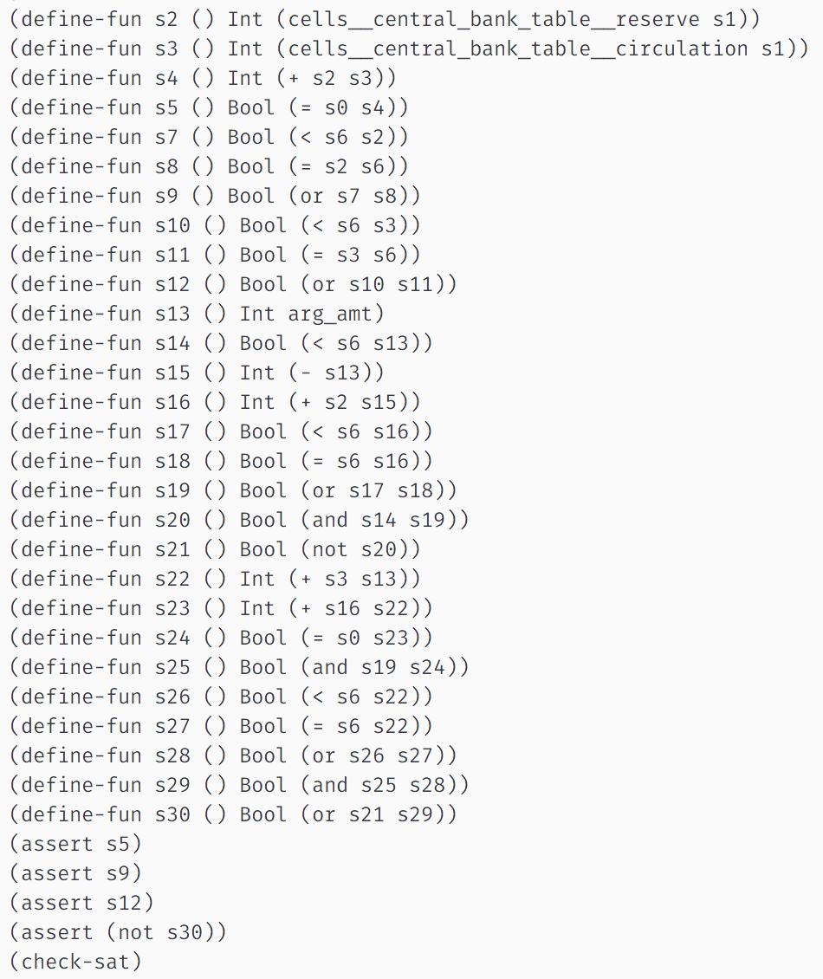
How does it work?
Lots of lisp
Notes:
Our program gets translated in to a set of constraints
At the end is an assertion that the property or invariant was not violated
Satisfiable = example bad inputs. Unsatisfiable = good

Slide 28
Limitations
The property checker itself is not formally verified
Unknown performance on large / difficult contracts
The properties we can express are somewhat limited
A contract is only as correct as its spec
Notes:
Properties are limited, but so is pact (and so is what should execute on the blockchain). In practice we can express everything we’ve wanted
Harder to figure out which properties to prove than to prove them. Smart defaults may help

Slide 29
Roadmap
defproperty
Module-level properties
Support as much of Pact as possible
Method visibility
Standard library
Improved tooling & UX
Verified implementation of the property checker

Slide 30
Joel Burget - joel@monic.co

